Slide 1
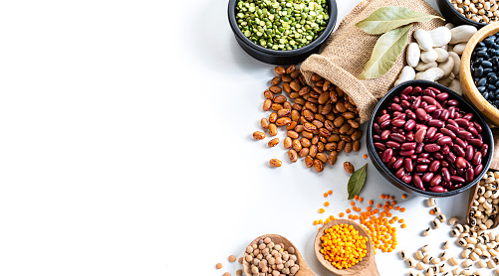
PRESENTATION ON
DRY BEAN CLASSIFICATION
(USING MACHINE LEARNING MODELS)
Presented By:
Fuzail Ahmed
Shreya Pendkur
Srinivas DS
Sushree Sangeeta Jena
Vidya Lekshmi

Slide 2

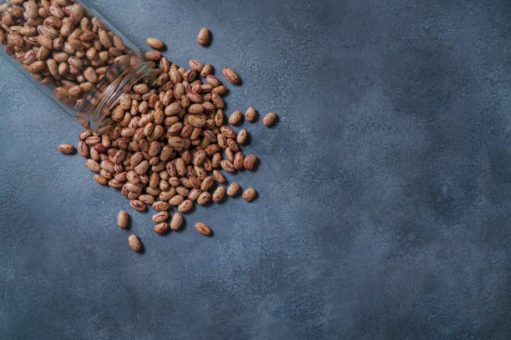
CONTENTS
01
Dataset Description
02
Exploratory Data Analysis
03
Visualization
04
Model Building
05
Conclusion

Slide 3
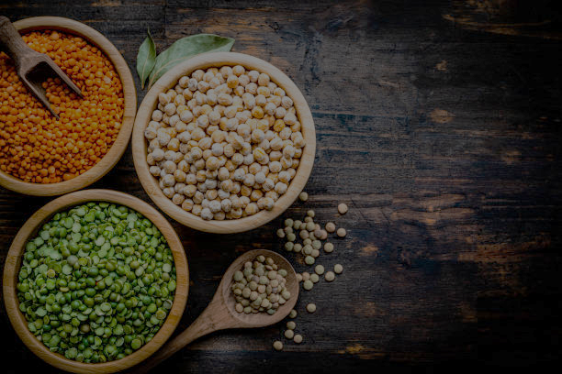
DATASET DESCRIPTION

Slide 4
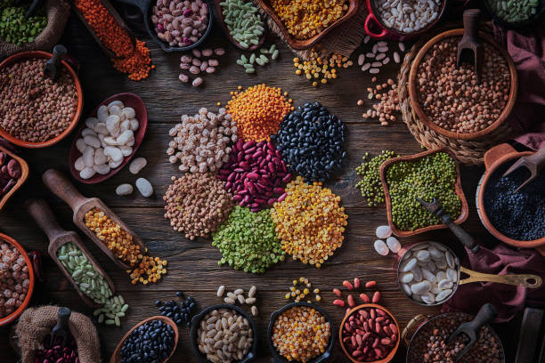
Context:
The dataset has 7 types of dry beans, taking into account the features such as form, shape, type and structure by the market situation. Here, we have 13611 data points with a total of 16 features taken into consideration.
Objective:
To predict the classes of dry beans with accuracy

Slide 5
Features:
Area (A): The area of a bean zone and the number of pixels within its boundaries.
Perimeter (P): Bean circumference is defined as the length of its border.
Major axis length (L): The distance between the ends of the longest line that can be drawn from a bean.
Minor axis length (l): The longest line that can be drawn from the bean while standing perpendicular to the main axis.
Aspect ratio (K): Defines the relationship between L and l.
Eccentricity (Ec): Eccentricity of the ellipse having the same moments as the region.
Convex area (C): Number of pixels in the smallest convex polygon that can contain the area of a bean seed.

Slide 6
Features:
Equivalent diameter (Ed): The diameter of a circle having the same area as a bean seed area.
Extent (Ex): The ratio of the pixels in the bounding box to the bean area.
Solidity (S): Also known as convexity. The ratio of the pixels in the convex shell to those found in beans.
Roundness (R): Calculated with the following formula: (4piA)/(P^2)
Compactness (CO): Measures the roundness of an object: Ed/L
ShapeFactor1 (SF1), ShapeFactor2 (SF2),
ShapeFactor3 (SF3),ShapeFactor4 (SF4)
Class: Class- Seker, Barbunya, Bombay, Cali, Dermosan, Horoz and Sira

Slide 7
EXPLORATORY
DATA ANALYSIS

Slide 8
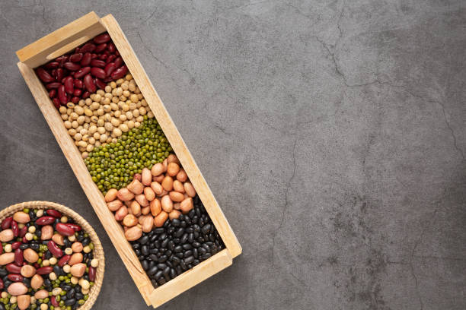
01
Missing Values
02
Outliers
03
Test for Linearity
04
Correlation
05
Dimensionality Reduction(PCA)
06
Balancing Classes(SMOTE)
07
Label Encoding

Slide 9
VISUALISATION

Slide 10
The data is dominant for a particular class, hence we have scope of biasness. So, we need to balance the classes prior to model building.

Slide 11
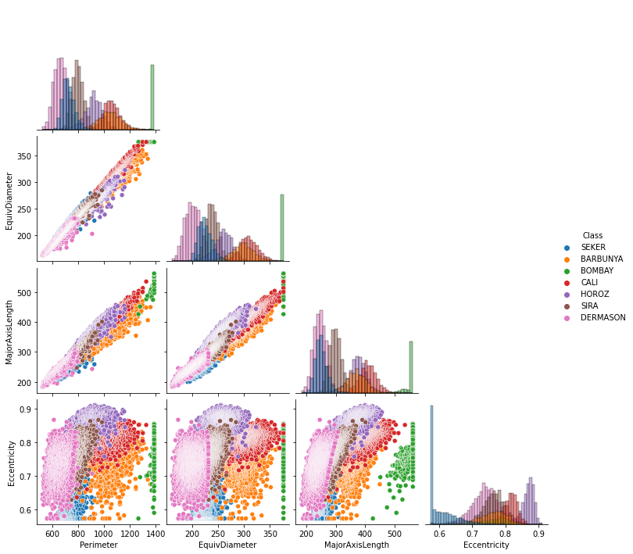
The Bombay variety has higher seed dimensions as compared to other varieties whereas the Dermason Variety has the lowest dimensions.

Slide 12
There is a positive relationship between Avg.Perimeter and Equiv.Diameter.
There is a positive relationship between Avg.Major Axis and Avg.Minor Axis.

Slide 13
MODEL BUILDING

Slide 14
Using Class as the Target Column:
DecisionTreeClassifier
RandomForestClassifier()RandomForestClassifier(n_estimators=100,min_samples_split=15,max_depth=10)
XGBClassifier(dual=False)
KNeighborsClassifier(n_neighbors=8)
AdaBoostClassifier
GradientBoostingClassifier
LGBMClassifier
CatBoostClassifier
SVC(kernel='linear'),SVC(kernel='rbf'),SVC(kernel='sigmoid'),SVC(kernel='poly’)
GaussianNB

Slide 15
CONCLUSION

Slide 16
01.
LGBM Classifier works the best as compared to other models
02.
It correctly classifies the Barbunya,Sira,Cali,Horoz,Dermason,Seker,Bombay varieties at 92%,100%,95%,93%,96%,96% and 88% respectively.(True Positive Rate)
03.
Model accuracy is 94 %

Slide 17
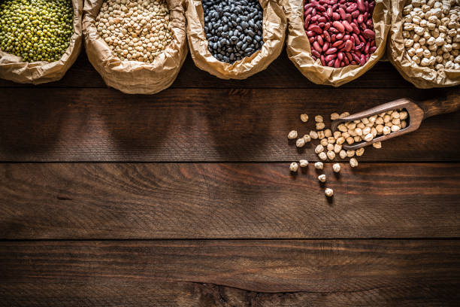
THANK YOU

